Slide 1
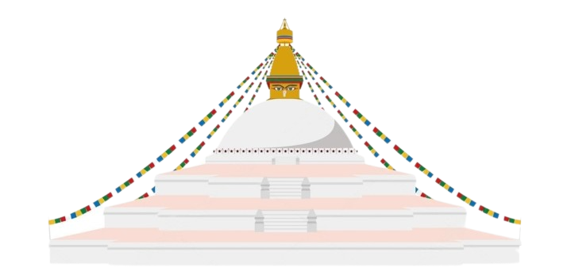

Monument Recognition Using cNN
A MINOR PROJECT ON

Slide 2
TABLE OF CONTENTS
01
Introduction
02
Literature Review
03
Problem Statement
04
Schlussfolgerungen

Slide 3
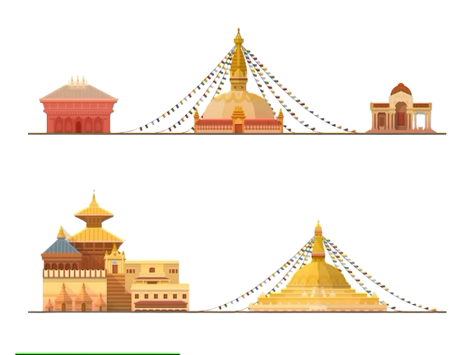
01
Introduction

Slide 4

Introduction
The developed system is a mobile application that implements Object Detection Machine models with the motive to serve as a tourist guide intending to detect and recognise the monuments and show their information.

Slide 5
“Preserving Historical Monuments Integrity and enhancing Tourism Experience with Machine Learning”

Slide 6

02
Literature Review

Slide 7
Literature Review
A
B
C
Landmark Recognition Using Machine learning
Towards DEEP LEARNING FOR ARCHITECTURE: A MONUMENT RECOGNITION MOBILE APP
Monument Recognition using Deep Neural Networks
Feature extractor; HOG scripter and classifier; SVM algorithm is used on 193 training images with model accuracy of 90%
Uses CNN algorithm based on the MobileNet model trained on 500 images per monument to develop a commercial iOS app with overall accuracy of the trained models estimated to be over 95%.
Transfer learning has been used only retraining the final layer of the Inception model with 400 images per monument. The model is tested on a few arbitrary images and results with a training accuracy and testing accuracy of 99.4% and 96-99% respectively.

Slide 8
D
E
F
Cross Platform Web based Smart Tourism Using Deep Monument Mining
Mobile Travel Guide using Image Recognition and GPS/Geo Tagging A Smart Way to Travel
Image based Indian Monument Recognition using Convoluted Neural Networks
Feature extraction: VGGNet model; transfer learning technique is used and classification algorithm: SVM and Random Forest are used for identification of monuments in the image.
This mobile app project uses Open-CV for image recognition and GPS navigation system with Google Maps API to point the location of that monument on the map. The application compares two images (camera's captured image and images stored in the database) using histogram comparison and feature detection using the ORB method.
Experiments on different method of extraction of features using hand crafted features and CNN. The models trained on manually obtained dataset of 50 images per monument accuracy of 92.7% on DCNN using fc6 layer.

Slide 9

03
Problem Statement

Slide 10
Problem statement
Problem 01
problem 02
Tourists are provided with small booklets which contains limited information of heritage sites which gets lost eventually.
The general public have poor knowledge and declined interest on monuments and heritages.

Slide 11

04
Objective

Slide 12
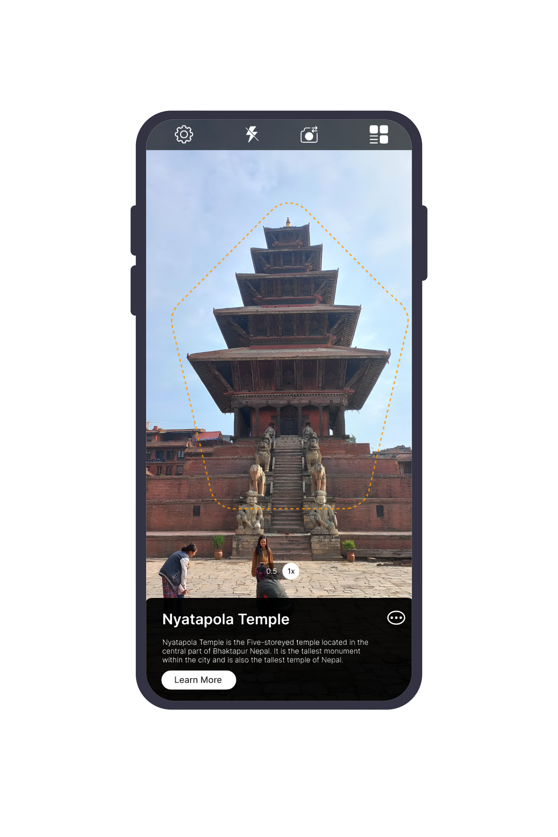
Objective
To build a mobile application that can identify and provide description about recognized monuments as well as show nearby services like hotels, ATM etc.

Slide 13

05
Dataset

Slide 14

Dataset collection
Image collection of 9 different monuments of Bhaktapur Durbar Square using smart phone camera.
Image collection of 9 different monuments of Bhaktapur Durbar Square using smart phone camera.
Image collection of 9 different monuments of Bhaktapur Durbar Square using smart phone camera.

Slide 15
DATASET collection timestamp
mORNING
Images Collected at 8 AM
dAY
Images Collected at 12 PM
eVENING
Images Collected at 5 PM
nIGHT
Images Collected at 7 PM
Note: All the images were captured using Mobile phones on site.

Slide 16

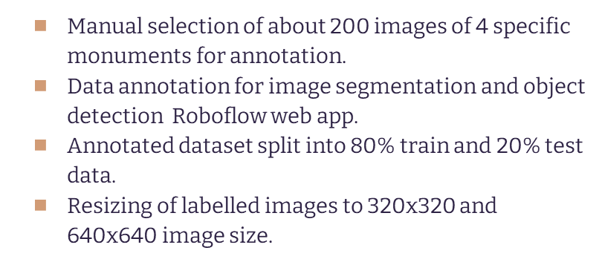
Dataset Pre-processing

Slide 17
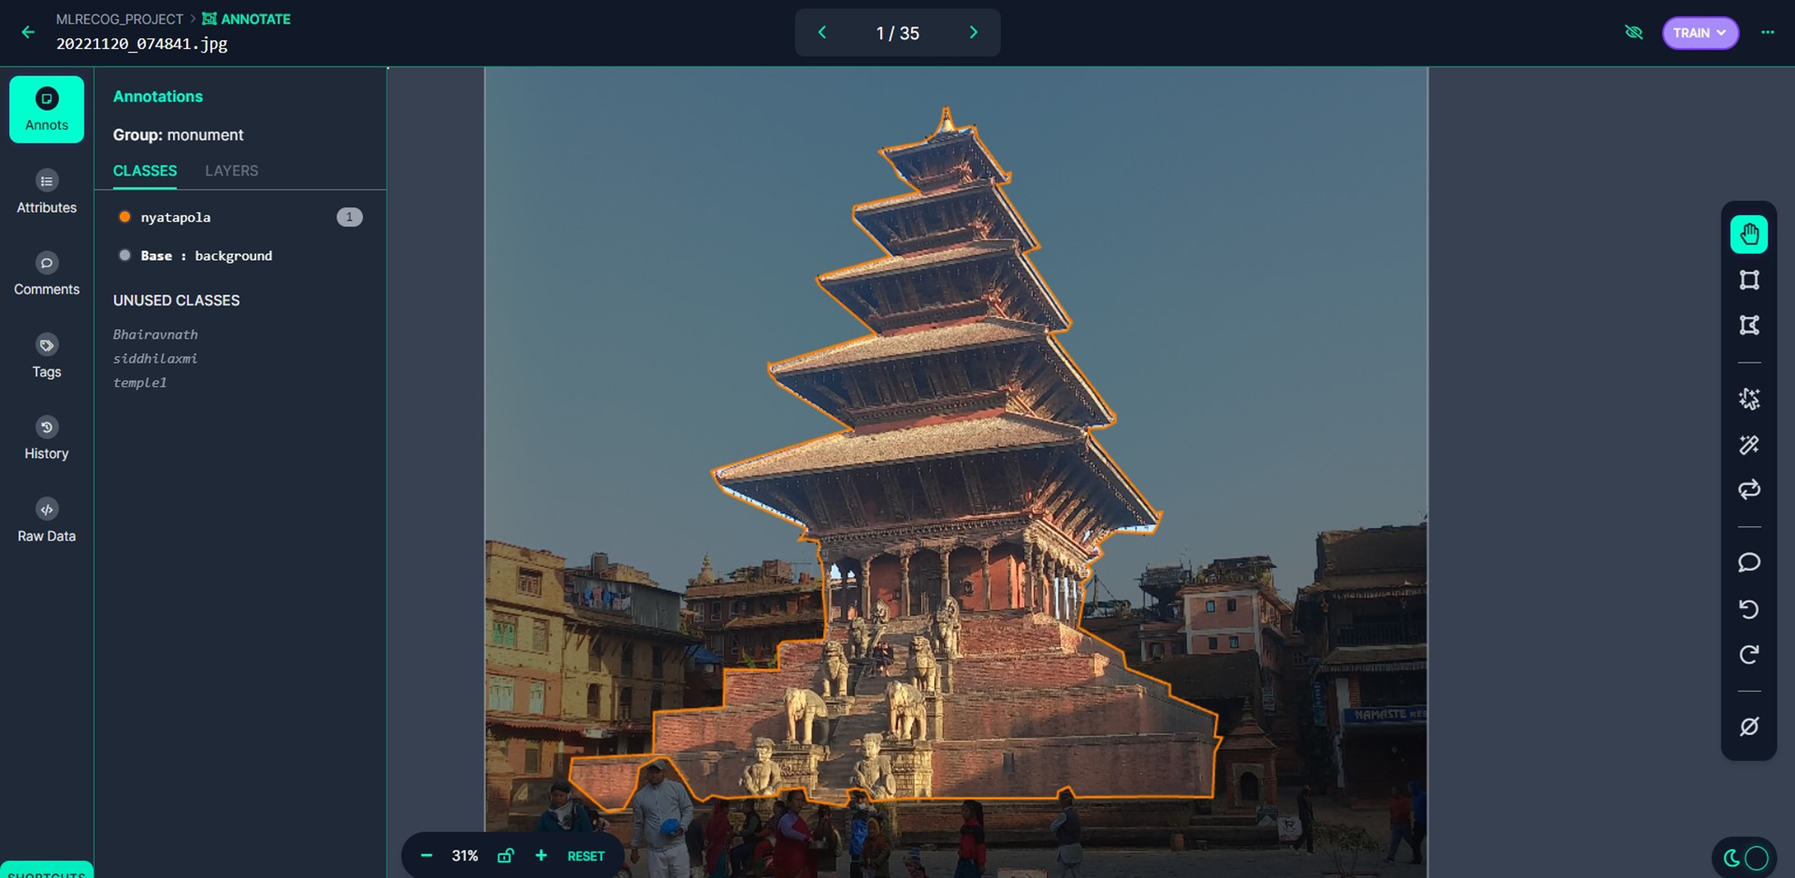

Slide 18
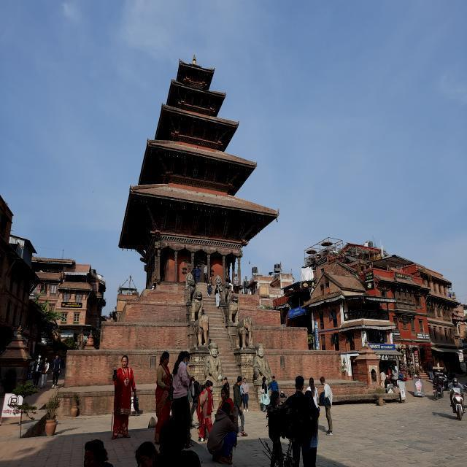
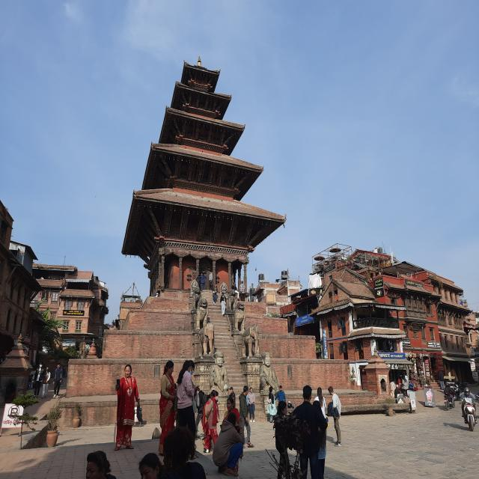
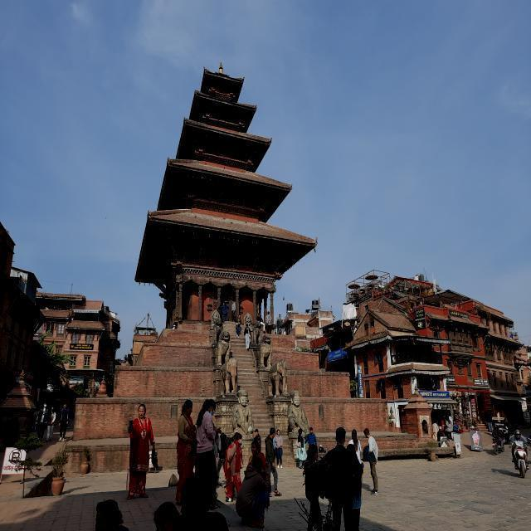
Dataset Augmentation
Brightness
Randomly alters brightness between range of ± 15% of original images brightness and picks 3 images

Slide 19
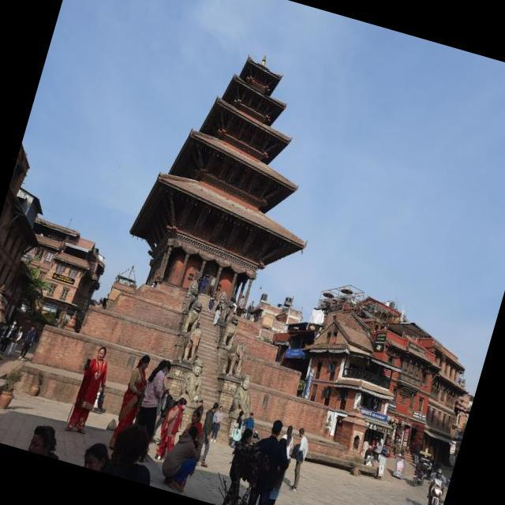
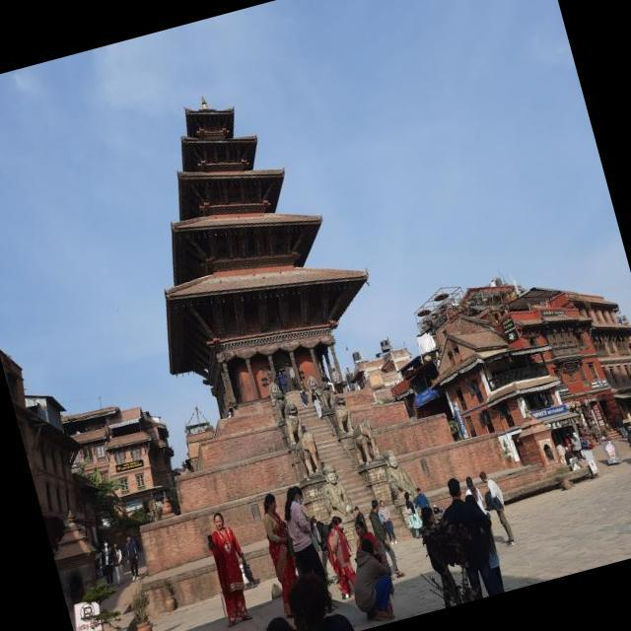

Rotation
Randomly rotates image between the range of ± 20° and picks 3 images

Slide 20
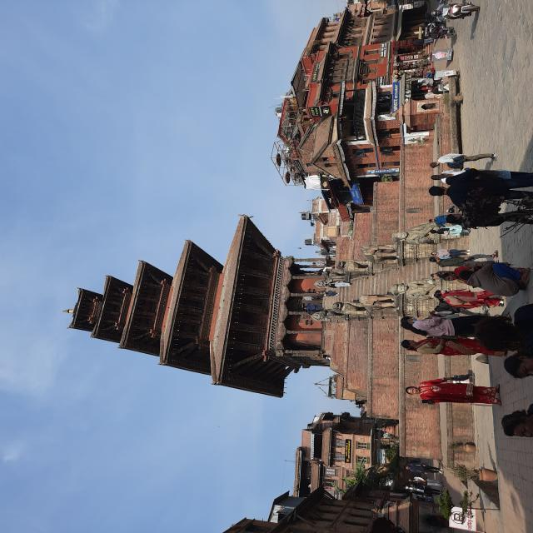
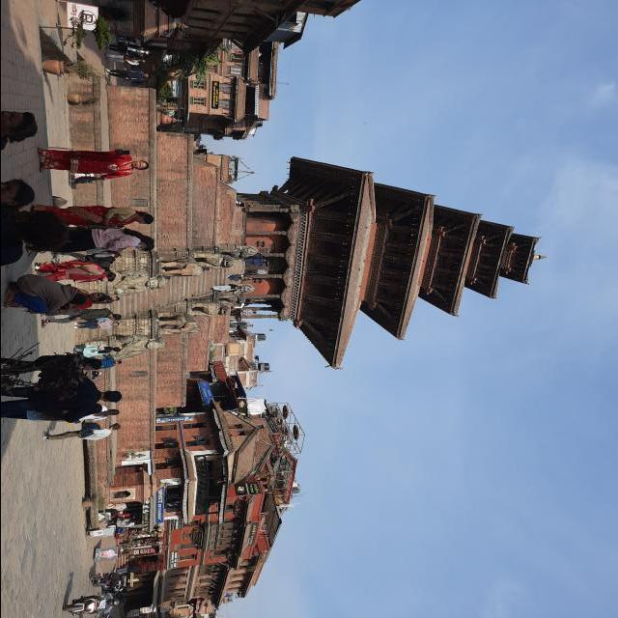
90° Rotate
Clockwise and anti-clockwise rotation.

Slide 21
Total Dataset
 | original | Train/test | Augmented | Total
Nyatapola | 202 | 80%/20% | 954 | 3,298
Bhairavnath | 202 | 80%/20% | 870 | 3,095
Vatshala Devi | 202 | 80%/20% | 910 | 2,980
Gopinath | 202 | 80%/20% | 980 | 3,450
Random Images | 60 | 100% | 0 | 60
Note: Data Augmentation is applied on Train images only.
Random Images are used to teach model about negative images.

Slide 22
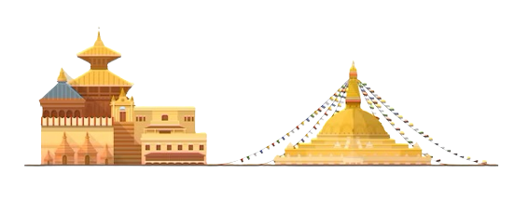
6,150
6,350
173
Train
Total Images
Test

Slide 23

06
Methodology

Slide 24
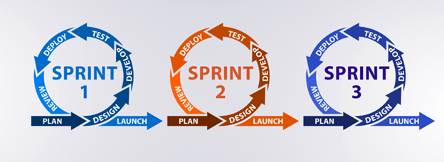
Method of software development
Scrum model of Agile Methodology is used.

Slide 25
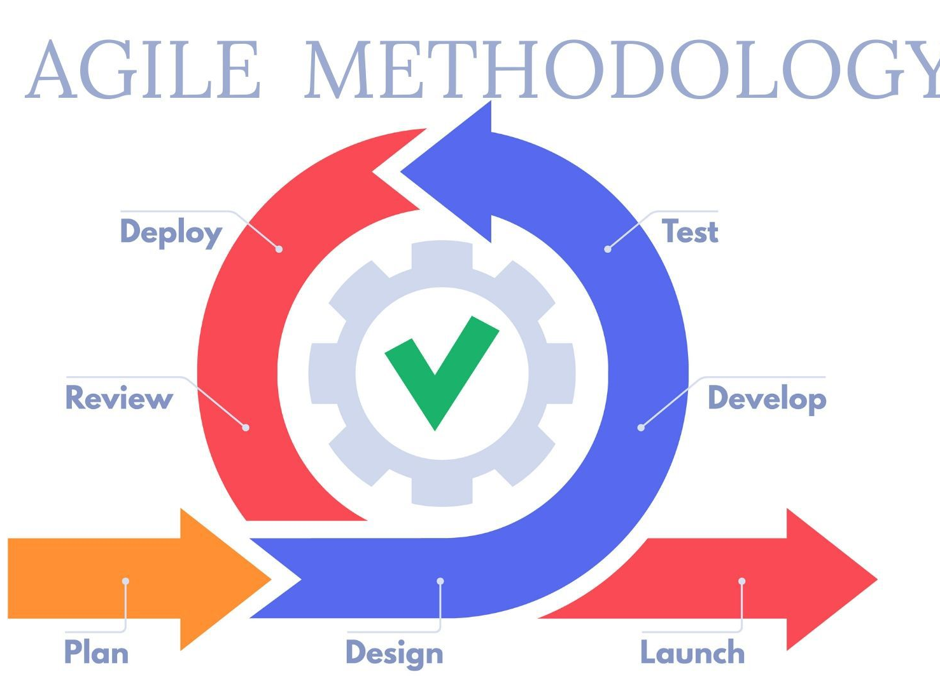
Why Agile?
Improved project predictability.
Reduced risks
Increased flexibility
Improved team morale

Slide 26
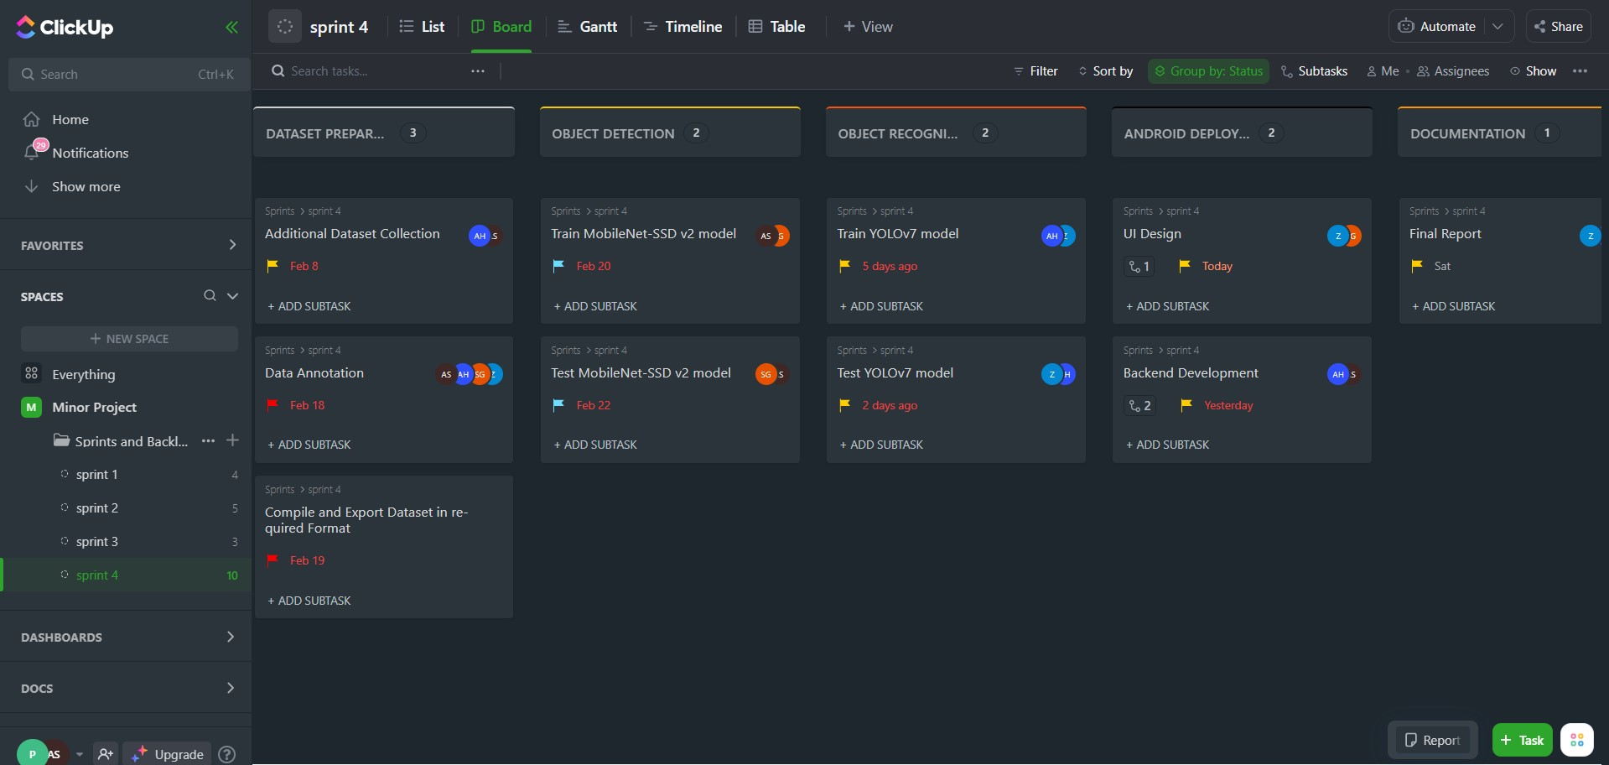
ClickUp As Project management tool

Slide 27
Sprint 1
Dataset Collection
Data Annotation
Training MobileNet-SSD v2 model
Testing MobileNet-SSD V2 model

Slide 28
Sprint 2
Data Labeling for Semantic Segmentation
Training YOLOv7 model
Testing YOLOv7 model

Slide 29
Sprint 3
UI design
VM setup on Server
Deployment of YOLOV7 on Server
Frontend Development
Backend Development
Model Evaluation and Visualization
Deployment of MobileNet-SSD v2 in Mobile app

Slide 30
Sprint 4
Increased Dataset
False negative data
Database creation
Model Optimization

Slide 31
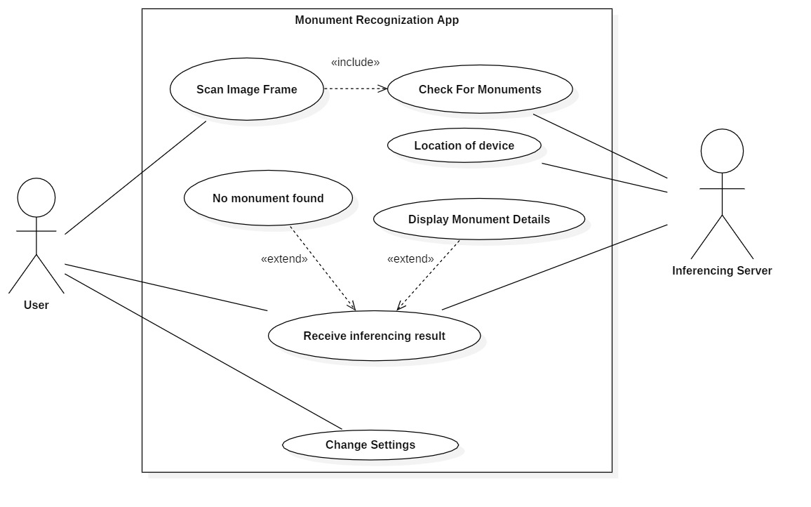
Use case Diagram

Slide 32
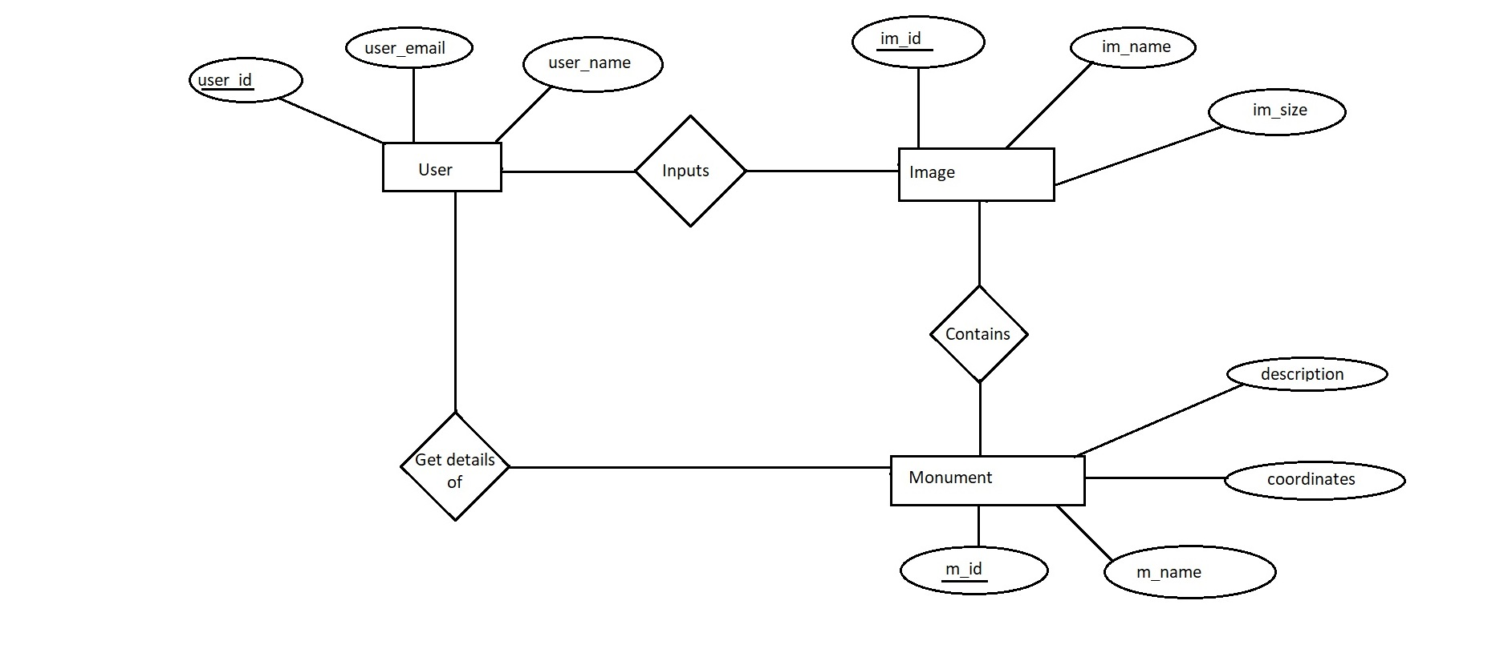
ER - Diagram

Slide 33
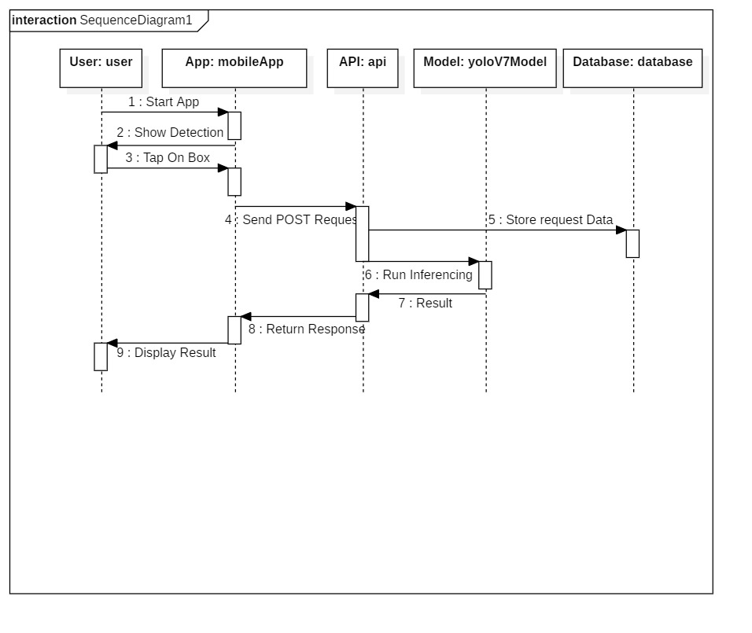
Sequence diagram

Slide 34
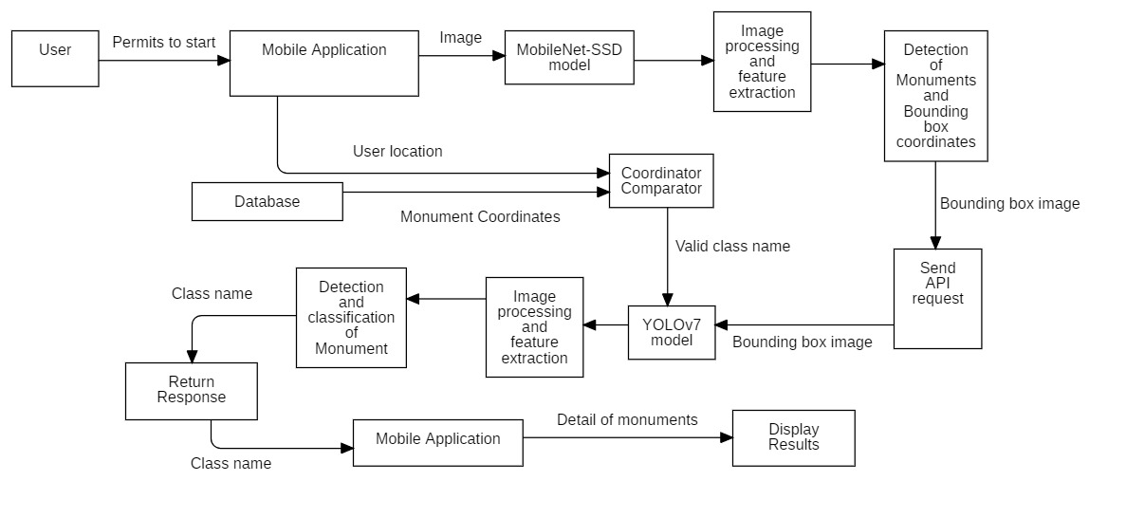
Block diagram

Slide 35
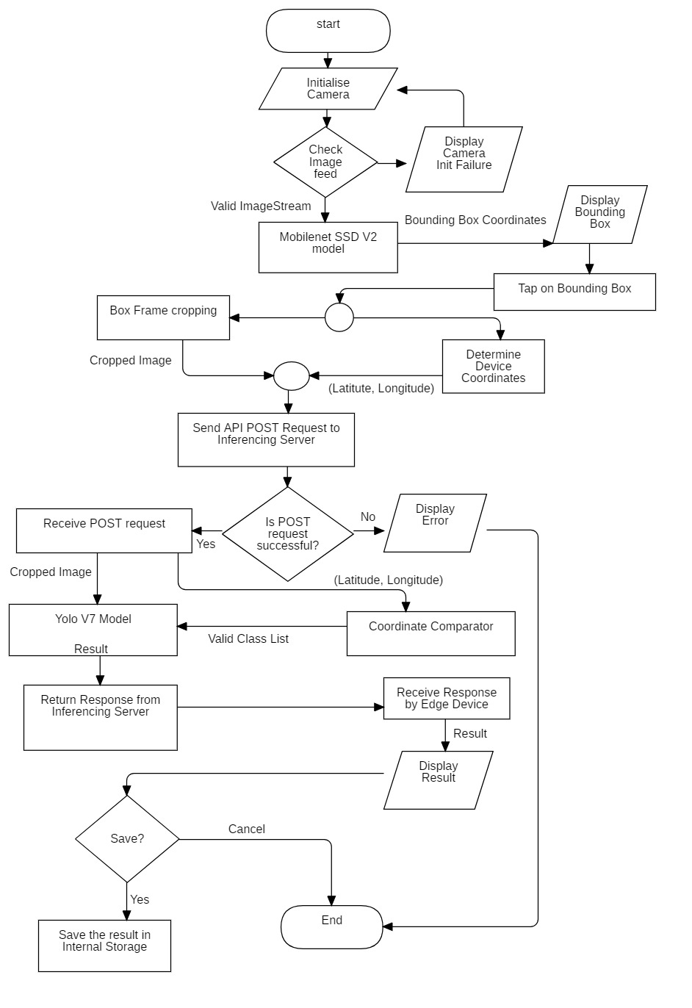
Flowchart

Slide 36
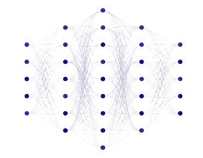
06
Models

Slide 37
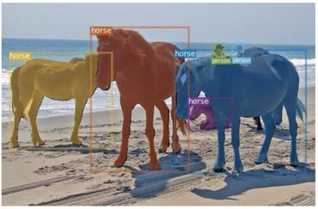
Yolo v7
One stage object detection architecture in computer vision.
Single shot detector as it makes predictions for multiple objects in an image in a single forward pass of the network.
Well-suited for real-time applications.
Use of anchor boxes, which help to improve the accuracy of object detection.
Highly accurate and efficient.
Takes 640x640 size of input image
Range of applications are image recognition, object tracking, autonomous vehicles tracking, segmentation, etc.

Slide 38
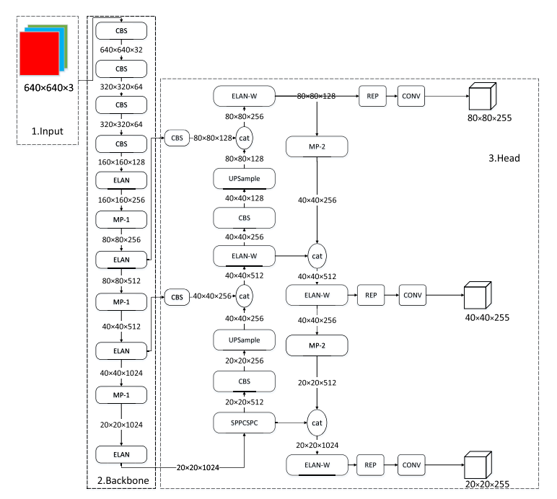
Architecture of yolo v7 model

Slide 39

How we implemented YOLOv7 ?
Yolov7 model running on the inferencing server which is hosted on Microsoft Azure VM instance.
Input for YOLOv7 is image sent by Android Device through API.
Used for monument detection, segmentation as well as classification.

Slide 40
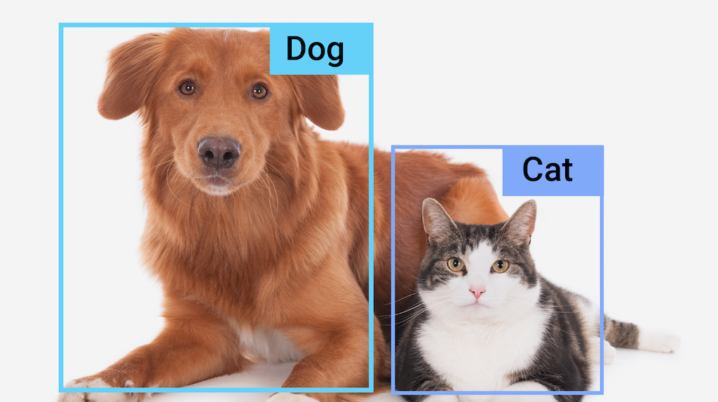
Mobilenet ssd v2
Consists of MobileNet V2 base architecture and SSD object detection head.
Takes 320x320 size of input image.
MobileNet v2 uses ReLU6 and SSD uses ReLU activation function.
Uses combination of Localization and Confidence loss functions.
Uses pointwise and depth-wise separable convolutional layers.

Slide 41
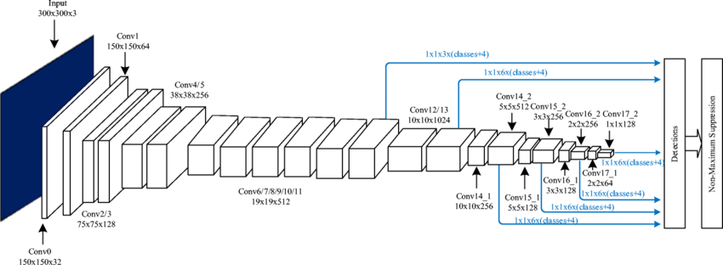
Architecture of Mobilenet ssd v2 model

Slide 42

How we implemented MobileNet-SSD?
MobileNet SSD V2 model remained in Android application.
Input is image captured by device camera.
Detects presence of monuments and gives bounding box coordinates.

Slide 43
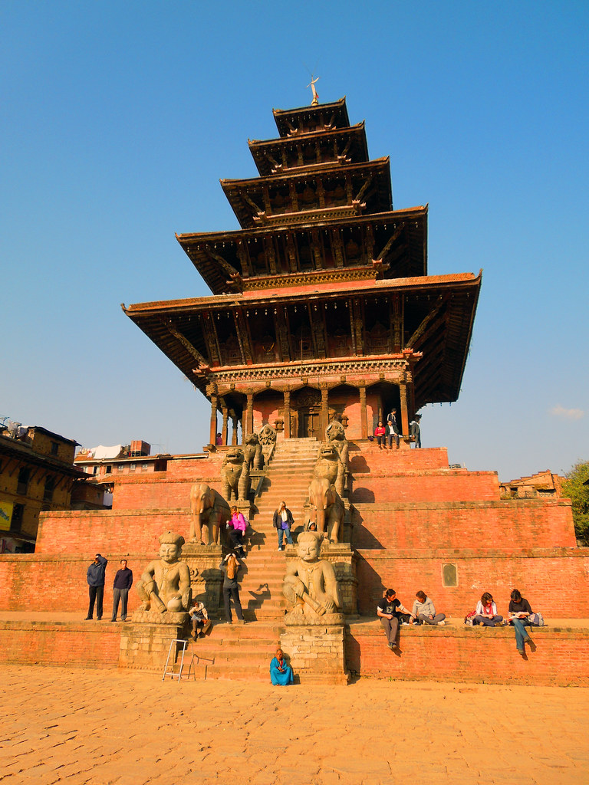
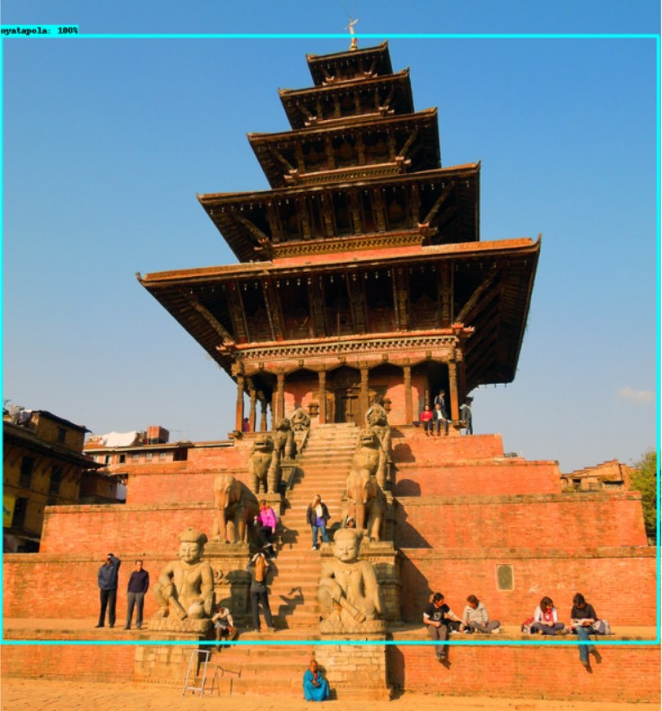
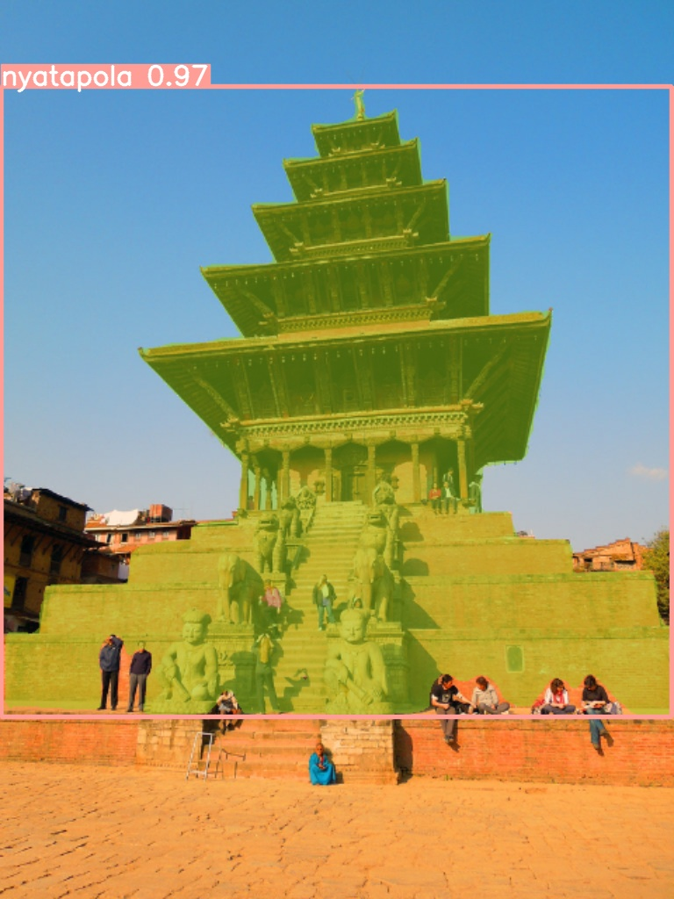
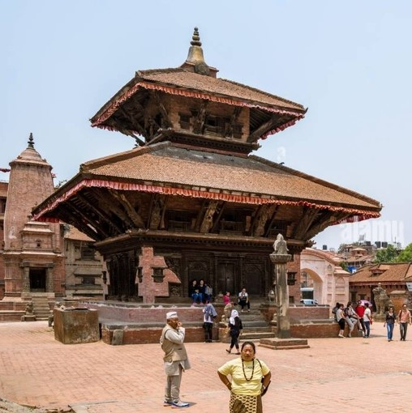
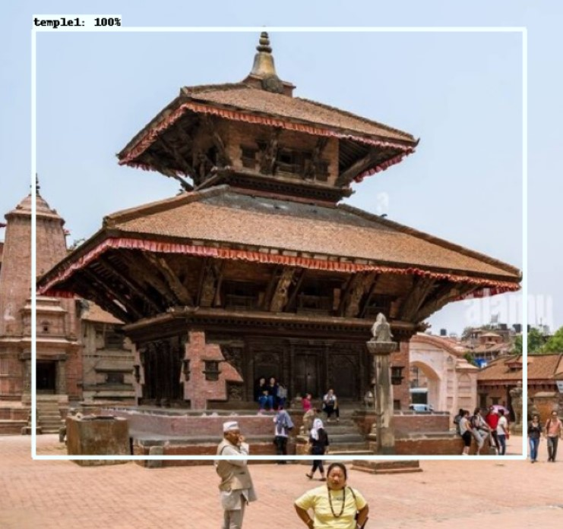
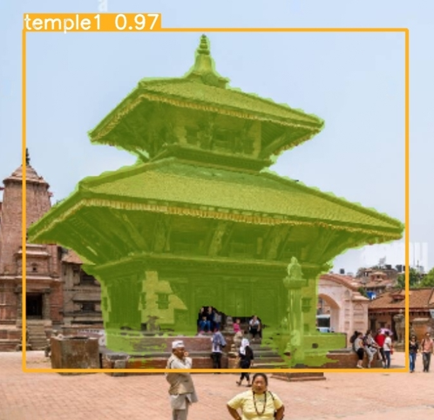
Unit test of detection and recognition module
Original Image Input
Detection Module Output
Recognition Module Output

Slide 44
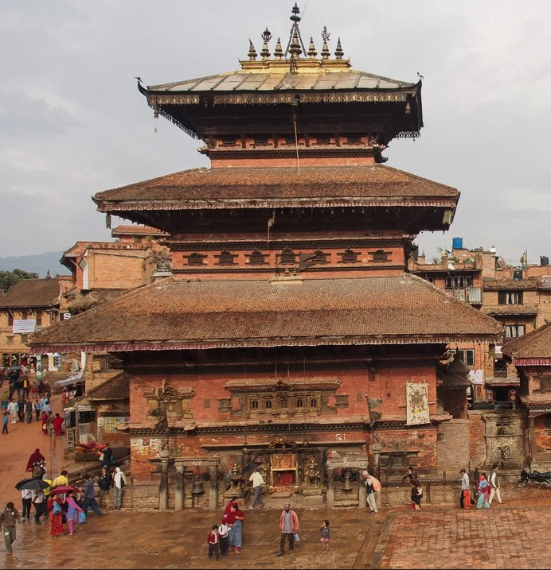
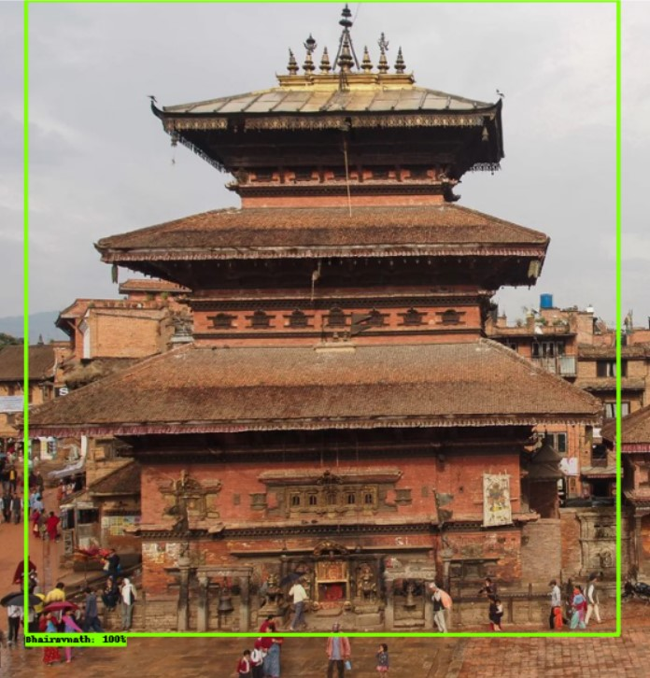
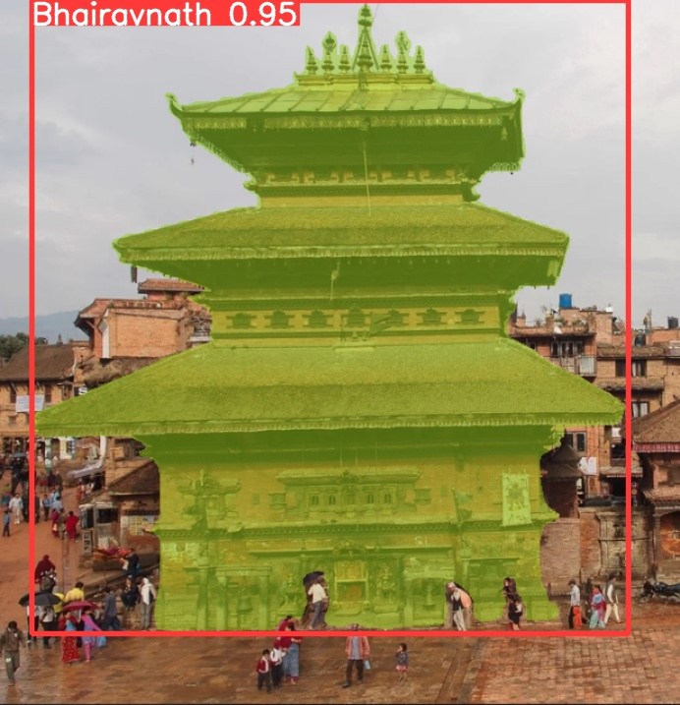
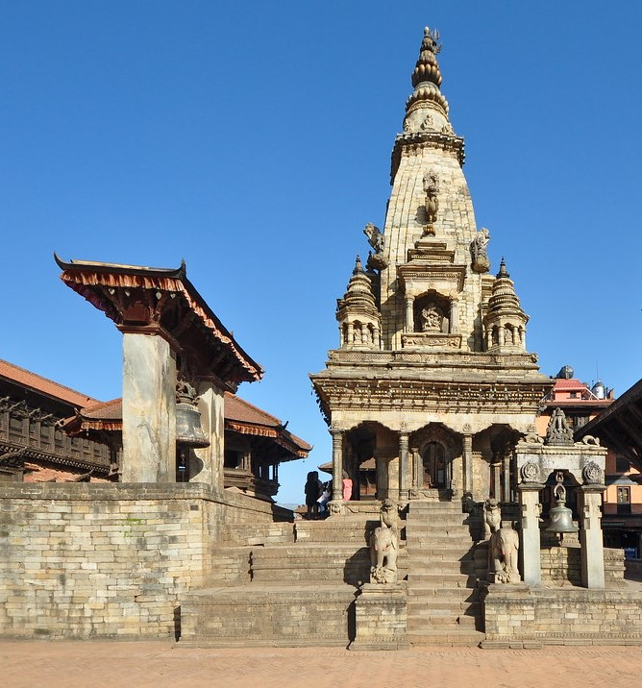
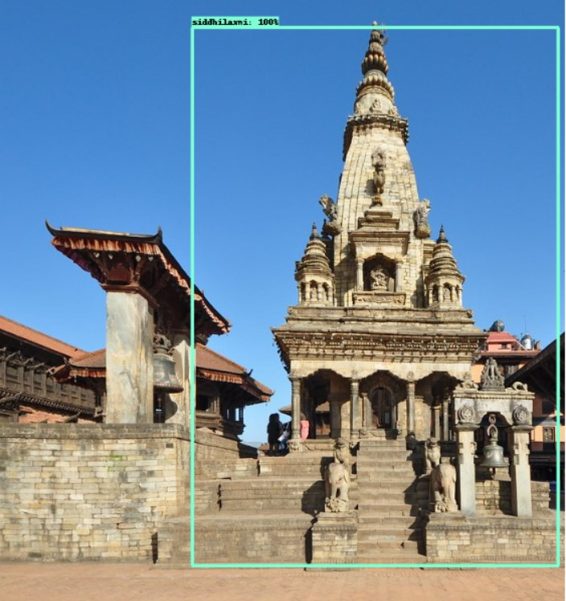
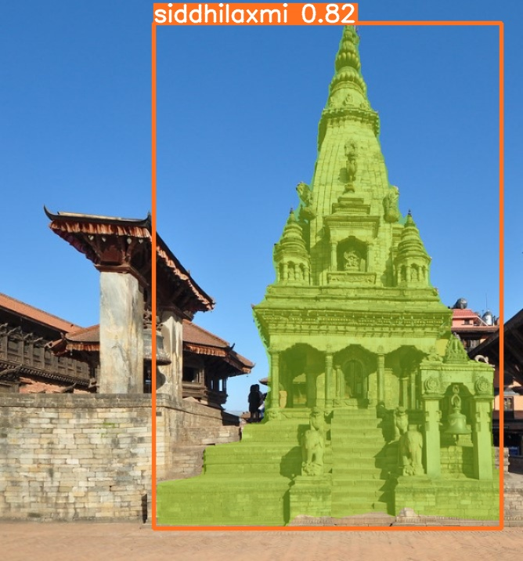
Original Image Input
Detection Module Output
Recognition Module Output

Slide 45
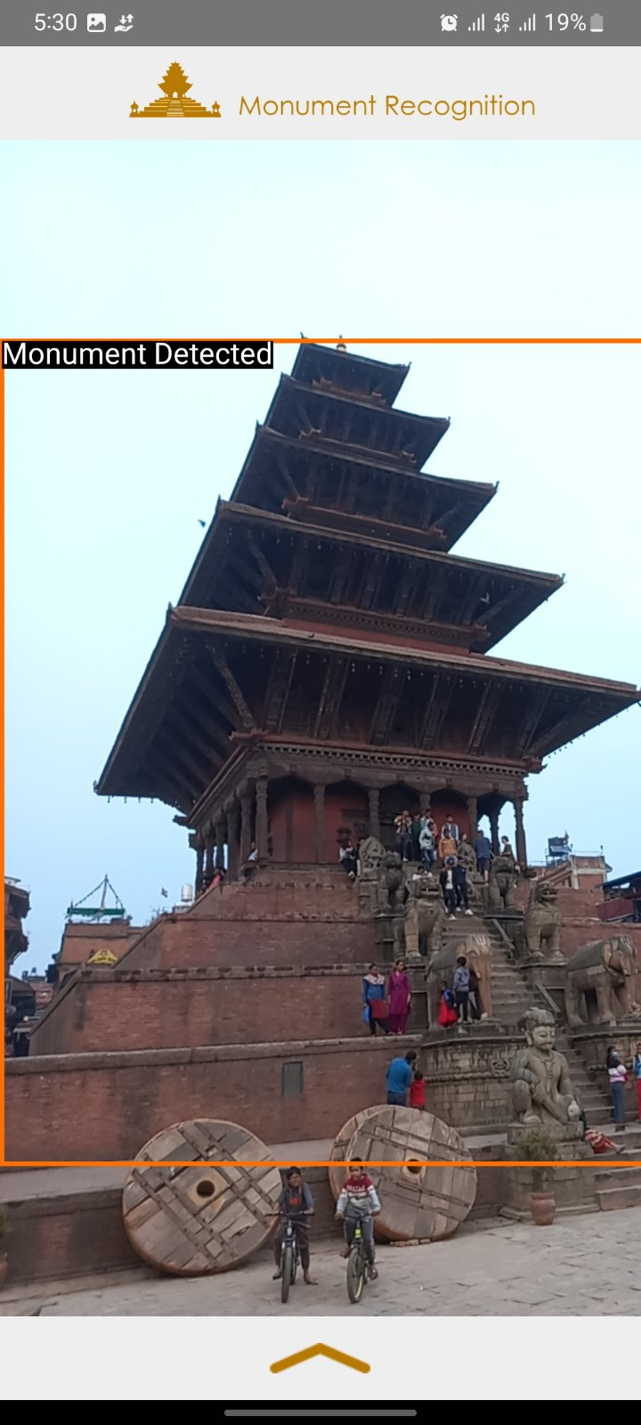
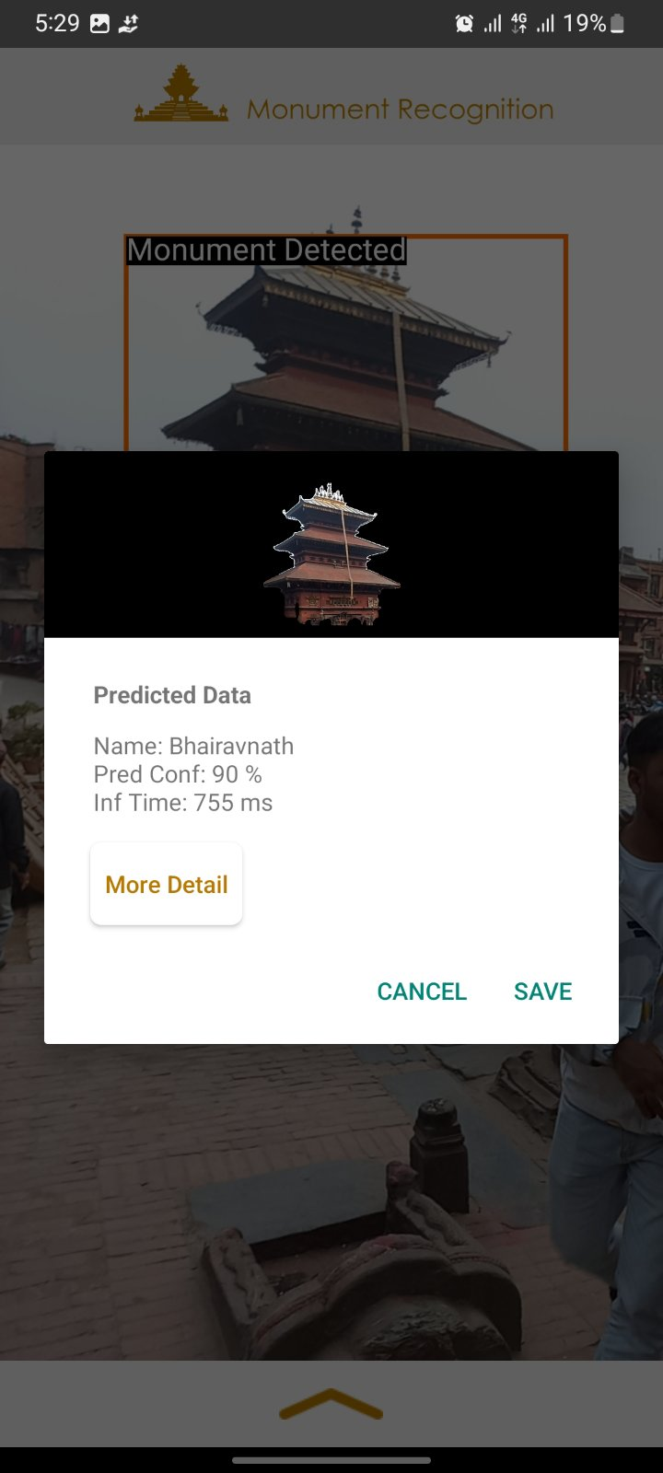
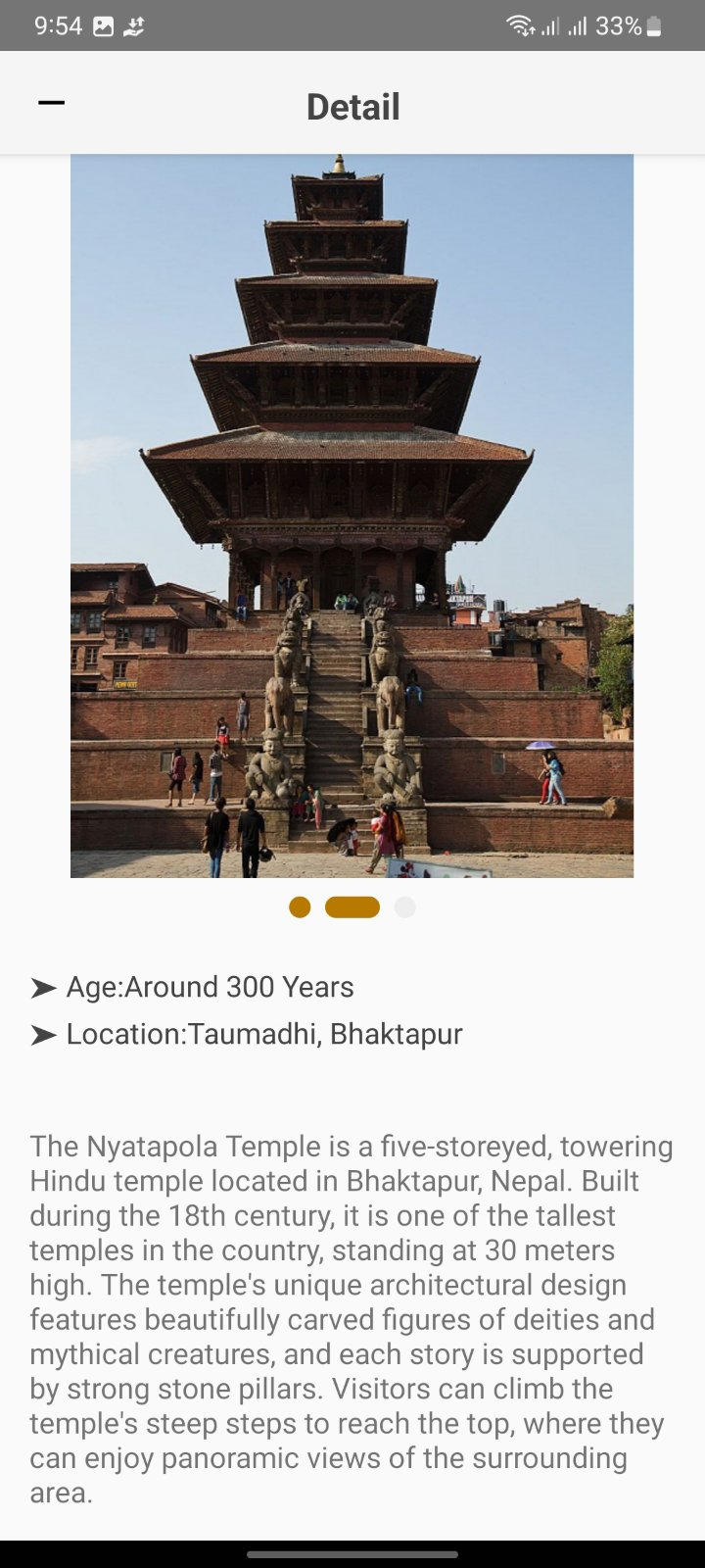
Integration Test of Monument Recognition System

Slide 46
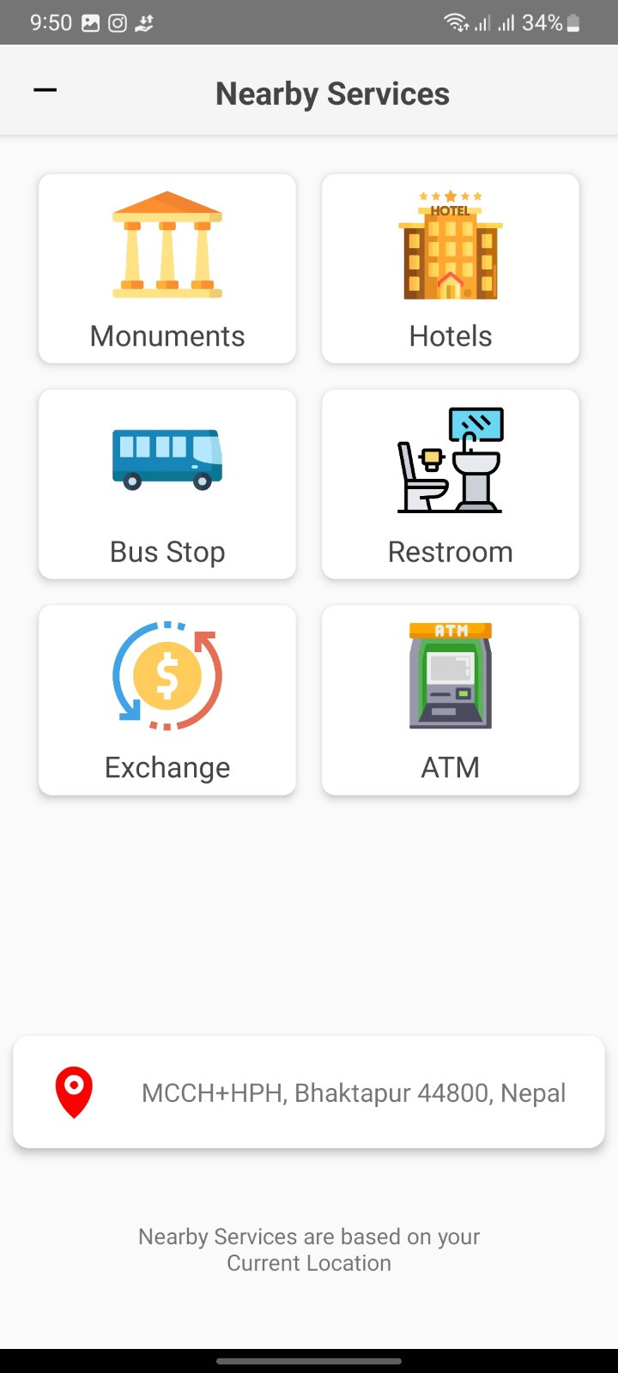
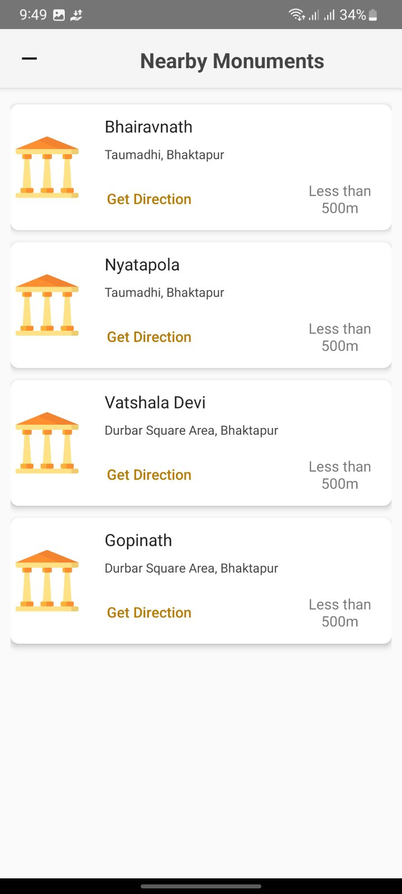
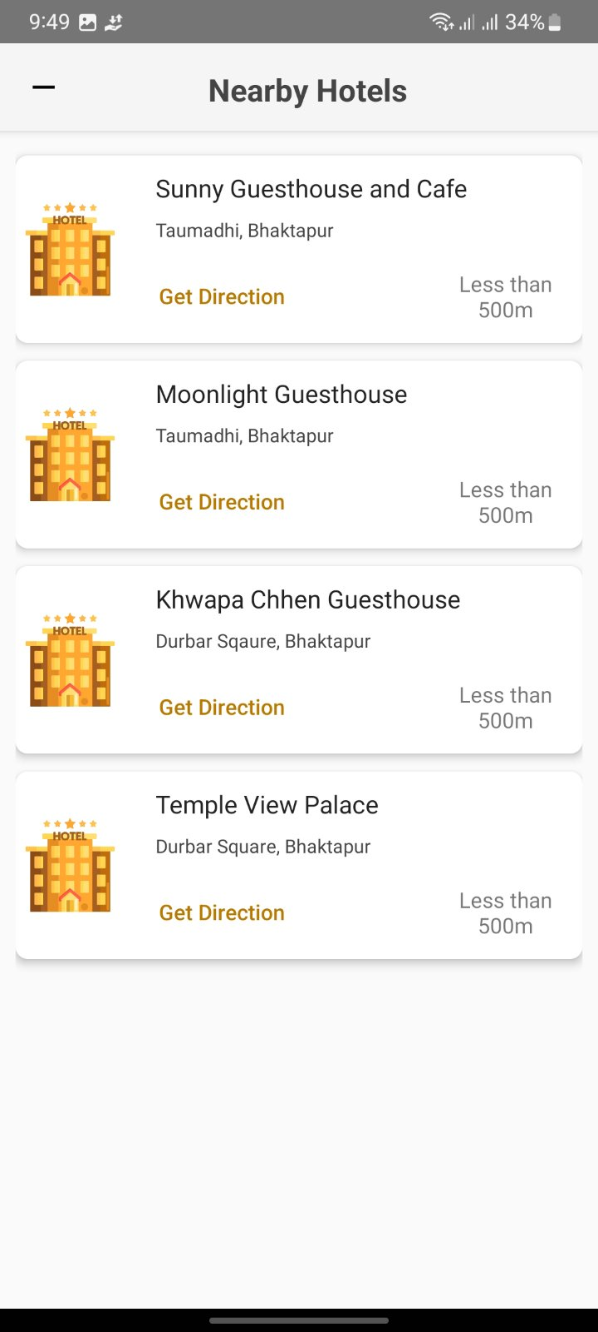

Slide 47
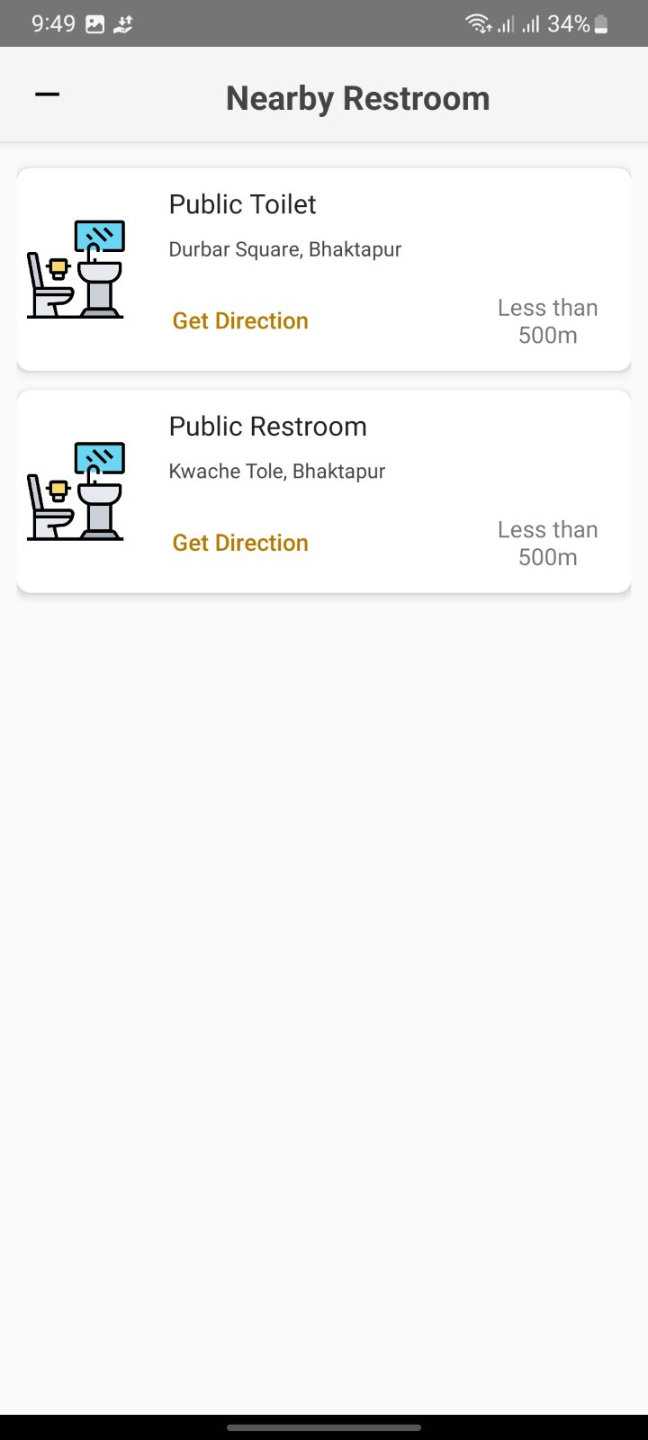
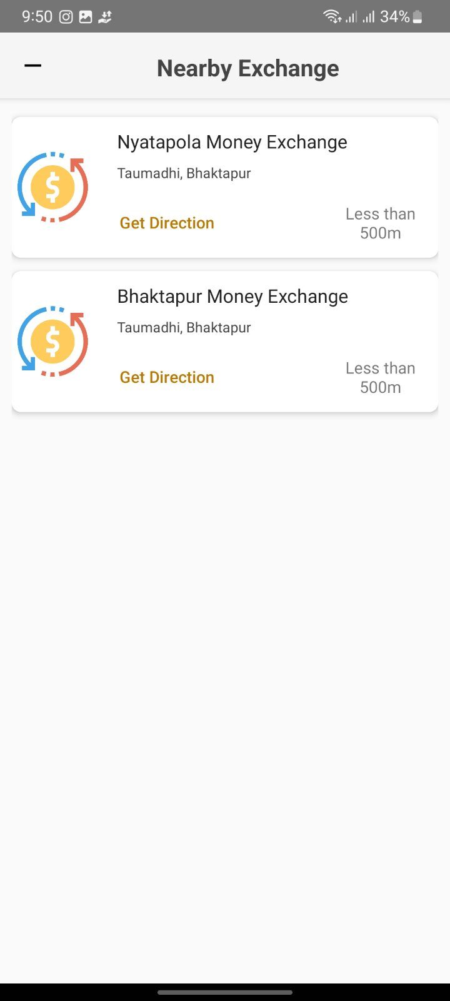
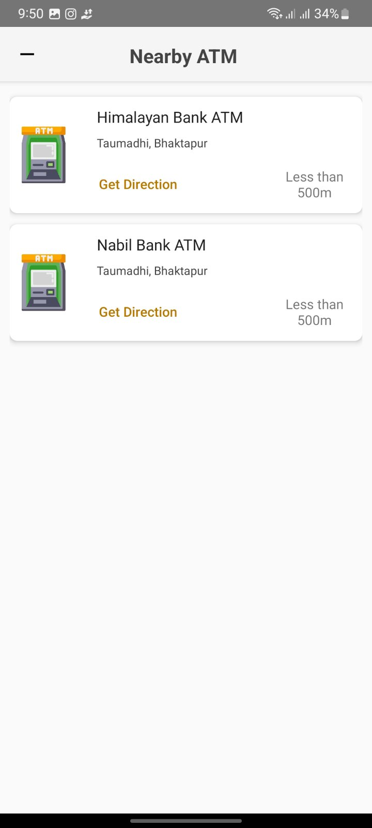

Slide 48

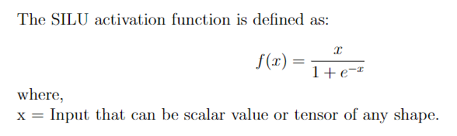
Hyperparameters used
Activation function
Mathematical function applied to introduce nonlinearity into the network. RELU - Used in MobileNet SSD V2 SILU - Used in YOLOv7
01

Slide 49

02
Batch size
Number of training examples utilized in one iteration of the algorithm.
Batch Size: 64 (MobileNet SSD v2) and 12 (YOLO V7)
03
Input size
YOLOv7 640x640.
MobileNet-SSDv2 320x320.
04
Learning rate
It is algorithms that determines the step size at which the model updates its weights during training.
MobilNet-SSD -
YOLOv7 -

Slide 50


Limitations and Future enhancement
Limitations
Enhancement
Training model on additional dataset of different monuments.
Expanding training dataset on different lighting and weather conditions.
Improving the detection and recognition accuracy.
Training model on additional dataset of different monuments.
Expanding training dataset on different lighting and weather conditions.
Improving the detection and recognition accuracy.

Slide 51

06
Requirements

Slide 52
Language and frameworks
PyThon
Tensorflow
Pytorch
Fast Api
High-level interpreted programming language
Open-source software library by Google for ML
used for training and inference of deep neural networks.
Open-source ML framework by Facebook used for computer vision and natural language processing.
Modern, fast, web framework for building APIs

Slide 53
Softwares used
Android Studio
Roboflow webapp
Clickup webapp
Postman
Official integrated development environment (IDE) for Android app development, uses Kotlin and Java
Cloud-based Webapp for annotating images
Project management Webapp tool to organize tasks, projects, and workflows in one central location
API development and testing tool

Slide 54
Platform and database
Microsoft azure
Google Colab
PostgreSql
Computing platform and infrastructure created by Microsoft, for deploying Backend System.
Cloud-based Jupyter notebook environment for running Python code
Open-source relational database management system for storing Monument data.

Slide 55
PC Hardware Specification
CPU
Ram
GPU
Storage
Intel Xeon Gold Processor 12Cores/24VCores
32 GB DDR3
Nvidia RTX 3080Ti 12GB
512 GB NVMe SSD

Slide 56
Mobile Device Specification
CPU
Ram/rom
Android version
Minimum: Octa Core
Recommended: Octa Core or above
Minimum: 2/16 GB
Recommended: 4/64 GB or above
Minimum API level: 21 (Android 5)
Recommended API level: 28 (Android 9) or above

Slide 57

06
Functional Requirements

Slide 58
Camera Stream
Monument detection
Monument Recognition
Initialise camera and scan the image stream
Detect potential monuments in image stream
Recognises the monument and creates segmentation mask
Monument description
Nearby services
Location service
Display monument details after recognition
Recommends nearby places or services based on real time location
Uses real time location for classification of potential monument

Slide 59

06
Non Functional Requirements

Slide 60
Reliability
Portability
Performance
The system should be reliable compared to traditional technical analysis methods.
The system in implemented as a mobile application so it is portable
The system is expected to perform with desired accuracy
Usability
Speed
Scalability
The system should be easy and simple to understand
The system should scan, process and describe image at high speed
The system should be scalable as per usage increase

Slide 61

Problem faced
False negative by Mobilenet ssd v2 model
Solved by adding random negatives images while training the model.
Failed model deployment in android app in flutter
Solved by switching to Android Studio (Kotlin and Java)

Slide 62

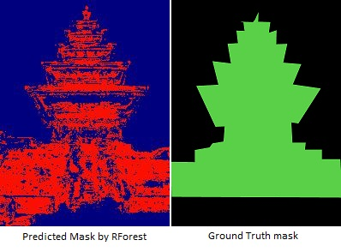
Experiments and result
Random forest for creating segmentation mask
Used traditional ML approach for image segmentation purpose, however got mediocre performance and heavy models, not suitable for large dataset and classes

Slide 63
Tried yolo v2 tiny model and deeplab v3 model as an mobilenet ssd v2 alternative
The performance of Mobilenet SSD V2 is superior as per speed, accuracy for detection and easy deploy ability. DeepLab V3 was used for on device segmentation but is not fine tuneable.
Tried mask Rcnn model and u-net for image segmentation
YOLO v7 segmentation model was superior in terms of speed and real time purpose as compared to Mask RCNN model. U-Net model could not be realised due to many runtime error and very poor result.

Slide 64

conclusion
To conclude, Monument Recognition System is completed successfully by making use of algorithms like YOLOv7 and MobileNet-SSD v2 and deployed as a mobile app which will help user to detect and recognize monuments and provide its description.

Slide 65

Thank you!
Do you have any questions?
monumentrecognition@gmail.com
Please, keep this slide for attribution

Slide 66
References

Slide 67




About our team
Abhisek Hyangol kCE076BCT004
Jenish Twayana kCE076BCT019
Samshrita Ghimire kCE076BCT033
Amit Shrestha kCE076BCT004

